Slide 1

NASA Space Mission Ai Solution
Kaylee Auguillard, Duc Nguyen, Tales Araujo Leonidas
Project Track: Conceptual Design Track

Slide 2


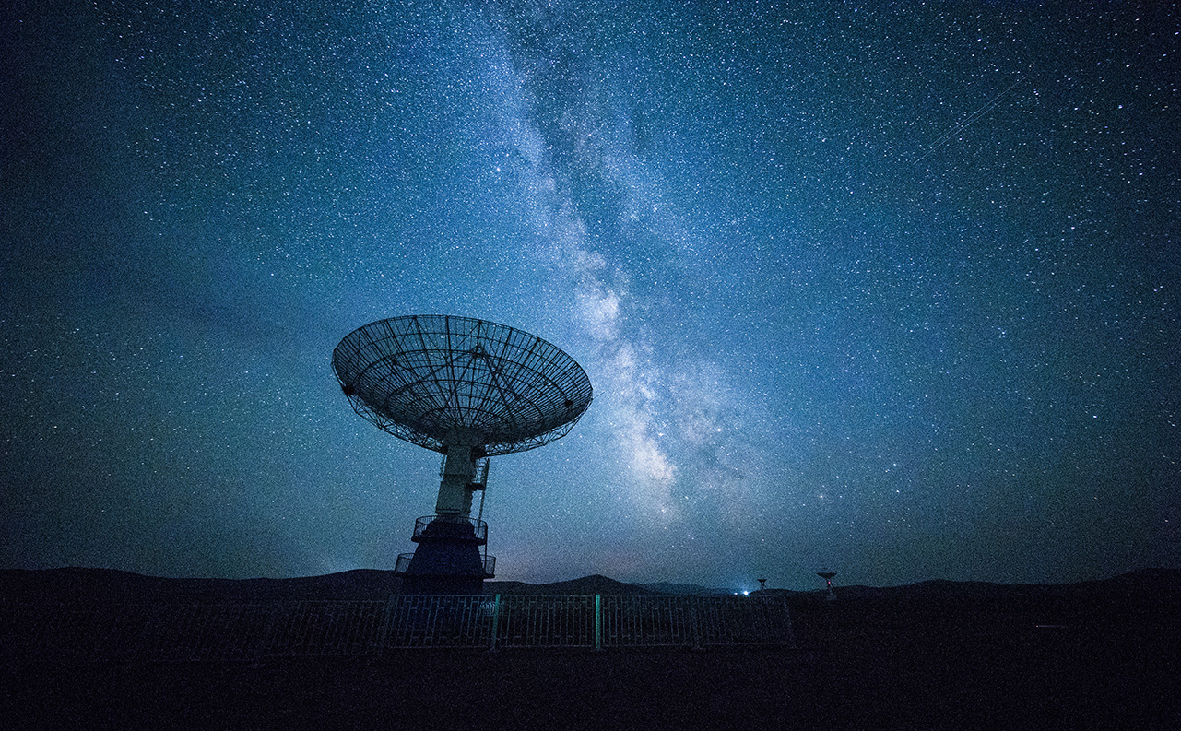
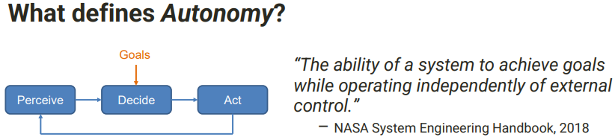
Problem Statement
Space missions face challenges like communication delays, limited resources, and unpredictable environments
Traditional navigation systems can't adapt in real time, risking mission success
An AI-powered navigation system can enable autonomous decision-making, improving spacecraft safety and efficiency

Slide 3

Project Overview and Objectives
Overview
AI-powered navigation and hazard-avoidance system
Machine learning and sensors for autonomous operations
Objectives
Ensure autonomous navigation
Optimize resource consumption
Enhance mission safety
Adapt to dynamic environments
Facilitate exploration of uncharted regions

Slide 4
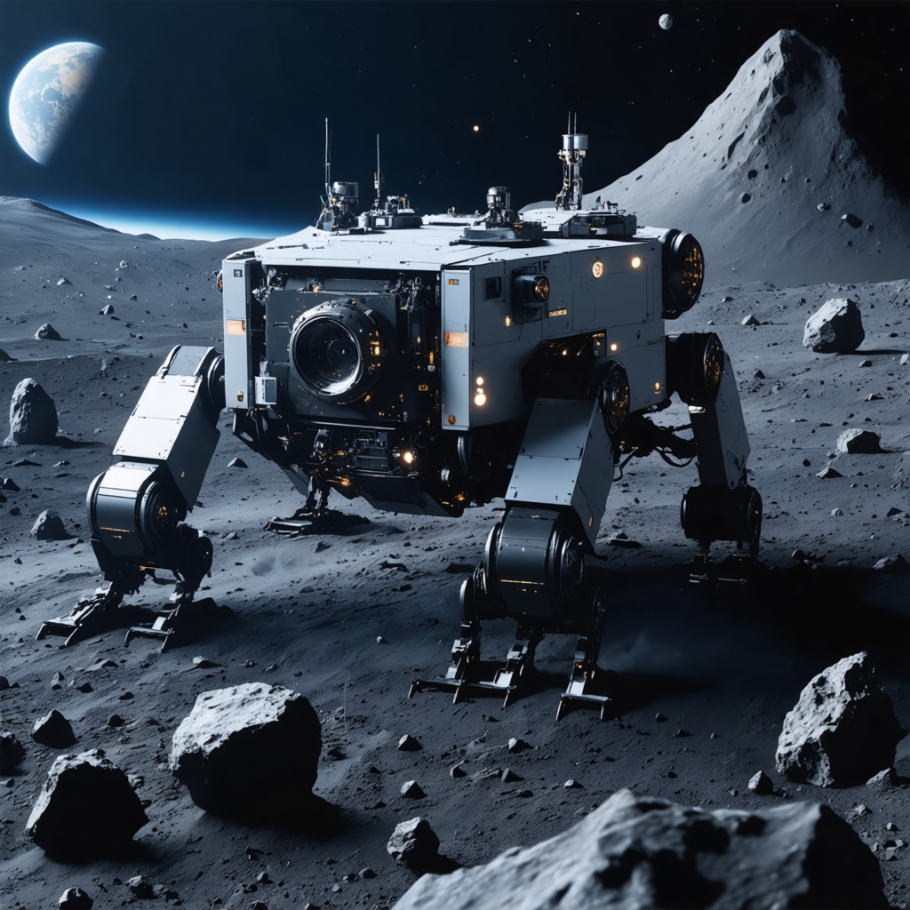
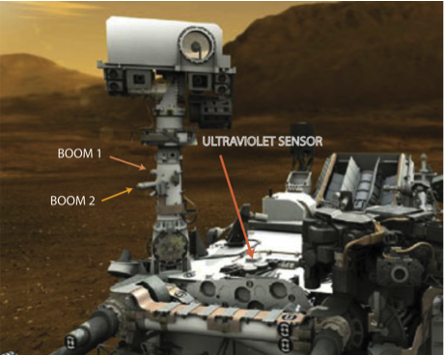
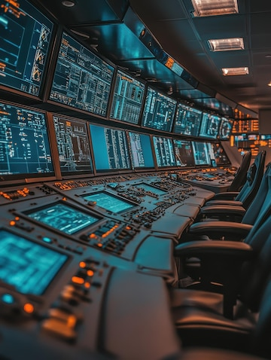
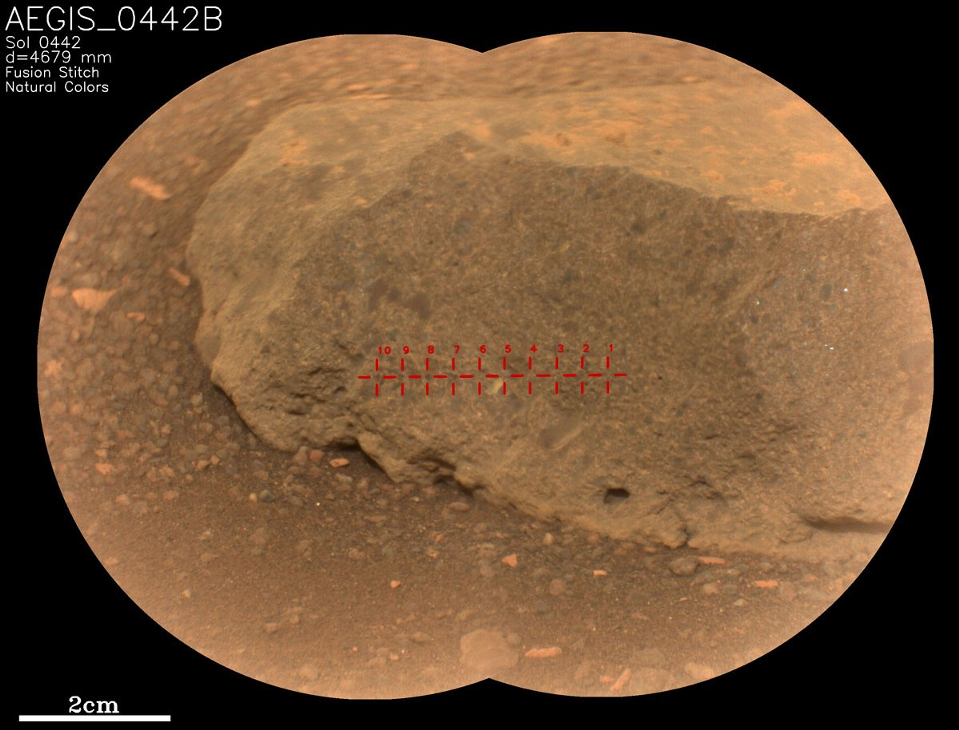
Use Cases
Autonomous Navigation:
Navigate through hazards like asteroid fields
01
Emergency Responses:
React to collisions or equipment failures
02
Resource Management
Monitor and optimize fuel, energy, and supplies
03
Exploratory Missions:
Analyze terrains for scientific exploration
04

Slide 5
Technical Components
AI Navigation SysteM
(Reinforcement Learning)
Sensor Integration
(Lidar, Radar, Cameras)
Resource Optimization Module
(Predictive Models)
Data Processing Pipeline
(Real-time Decision Making)
Decision-Making Framework
(Balancing Priorities)

Slide 6


Testing Plan
Navigation Accuracy: Route efficiency and hazard avoidance
Response Time: Quick decision-making in emergencies
Resource Efficiency: Fuel and energy usage optimization
Robustness: Performance under extreme conditions
Safety Testing: Collision and malfunction prevention

Slide 7
Challenges and Limitations
Data Availability:
Limited real-world data for training
Hardware Constraints:
Lightweight, energy-efficient components
Communication Delays:
Dependence on AI for real-time decisions
Power Management:
Balancing energy usage

Slide 8
Implementation Plan
Research & Requirements Gathering: Collaborate with NASA experts
System Design: Develop AI architecture and decision-making workflows
Prototype Development: Train AI in simulated environments
Testing & Validation: Evaluate performance metrics and adjust
Finalization & Documentation: Prepare a detailed project report

Slide 9
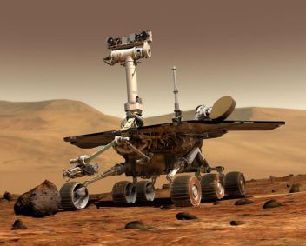
Conclusion
Autonomous navigation enhances mission success and safety
Reduces reliance on Earth-based guidance
Paves the way for interstellar exploration
Future expansion possibilities for deeper space missions

Slide 10
References
Adams, Caleb Ashmore, et al. "Advancing Autonomy in Distributed Space Systems: Insights From on-Orbit Testing with the Starling 1.0 Mission." 4S Symposium, European Space Agency, Palam de Mallorca, ES, 27-31 May 2024. https://ntrs.nasa.gov/citations/20240004120
Carbone, Marc. "AI-enabled Autonomous Systems: Space Power Applications." IAPG | Electrical Systems Working Group, NASA GRC, 10-12 March 2024. https://ntrs.nasa.gov/api/citations/20240002420/downloads/IAPG_2024_Final.pdf
NASA. "Autonomous Systems Help NASA's Perseverance Do More Science on Mars." NASA (.gov), 21 Sep. 2023. https://science.nasa.gov/mission/mars-2020-perseverance/
NASA. “Perseverance’s SuperCam Uses AEGIS For the First Time.” NASA, 7 Mar. 2024, https://science.nasa.gov/resource/perseverances-supercam-uses-aegis-for-the-first-time/
NASA JPL. "Machine Learning-Based Analytics for Autonomous Rover Systems (MAARS)." Jet Propulsion Laboratory, NASA. https://www.jpl.nasa.gov/missions/mars-2020-perseverance-rover/

